Slide 1
CAPSTONE FINAL PROJECT

Slide 2
INTRODUCTION
Project focused on basic necessity – FOOD
Lot of locations to choose from, which one to be selected?
Picked Mumbai city as a point for analysis

Slide 3
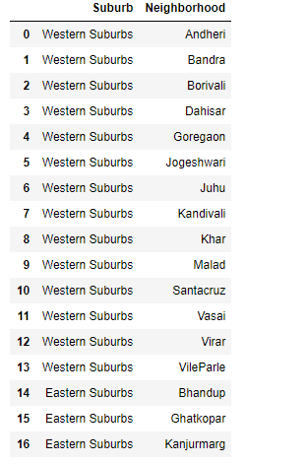
DATA
Reference - https://en.wikipedia.org/wiki/List_of_neighbourhoods_in_Mumbai

Slide 4
METHODOLOGY
Use of clustering algorithm
Clusters decided by elbow method
Clustered data based on the top venues in the neighborhood
Results derived through the folium map and cluster labels

Slide 5
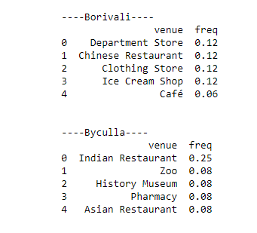
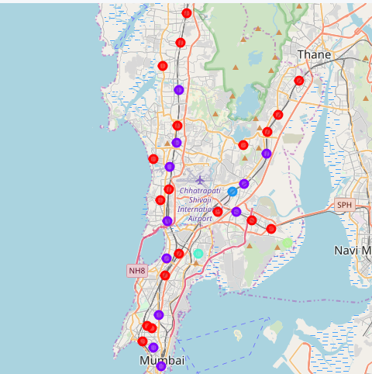
RESULT

Slide 6
DISCUSSION
Result to be selected – Bandra/Chembur
How can the data be further refined? Use of foot counts on the available restaurant data
Once established, restaurant business can easily run for 50-100 years

Slide 7
CONCLUSION
Use data to arrive at accurate results
Select one from Chembur/Bandra as a start up for Indian Restaurant

